Slide 1
Image Enhancement in the Frequency Domain

Slide 2
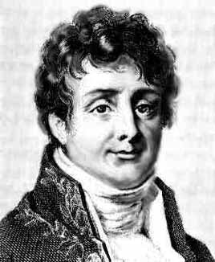
Jean Baptiste Joseph Fourier
Fourier was born in Auxerre,
France in 1768
Most famous for his work “La Théorie Analitique de la Chaleur” published in 1822
Translated into English in 1878: “The Analytic Theory of Heat”
Nobody paid much attention when the work was first published
One of the most important mathematical theories in modern engineering
Notes:
2

Slide 3
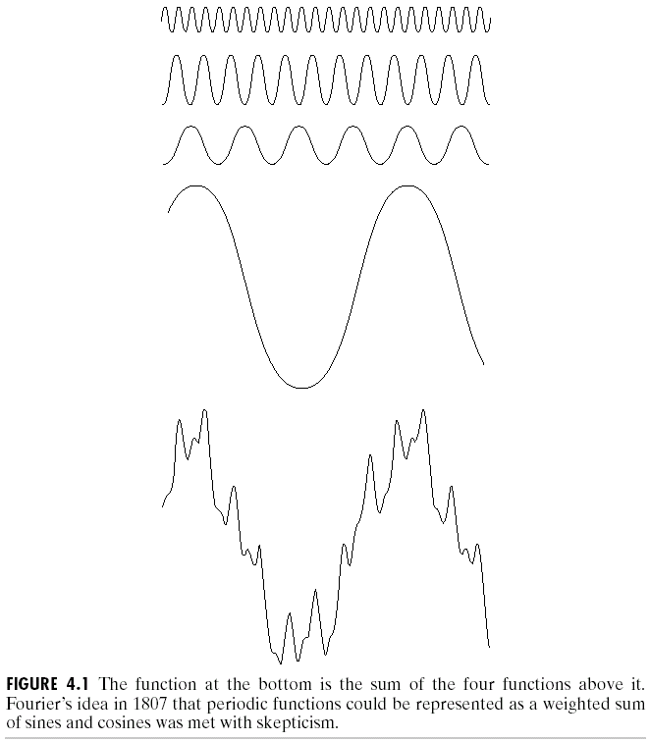

The Big Idea
=
Images taken from Gonzalez & Woods, Digital Image Processing (2002)
Any function that periodically repeats itself can be expressed as a sum of sines and cosines of different frequencies each multiplied by a different coefficient – a Fourier series
Notes:
3

Slide 4
The Big Idea (cont…)
Taken from www.tfh-berlin.de/~schwenk/hobby/fourier/Welcome.html
Notice how we get closer and closer to the original function as we add more and more frequencies
Notes:
4

Slide 5
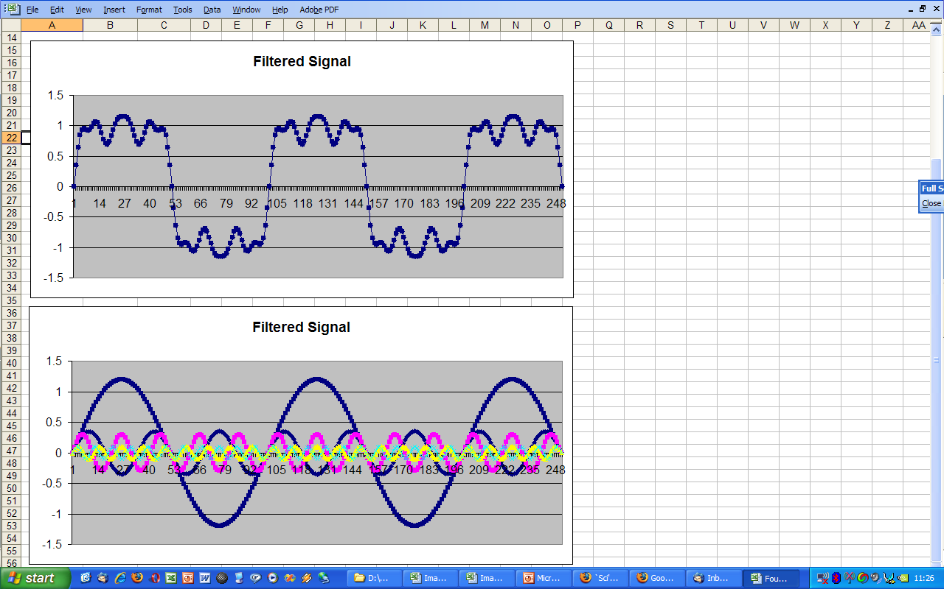
The Big Idea (cont…)
Frequency domain signal processing example in Excel
Notes:
5

Slide 6
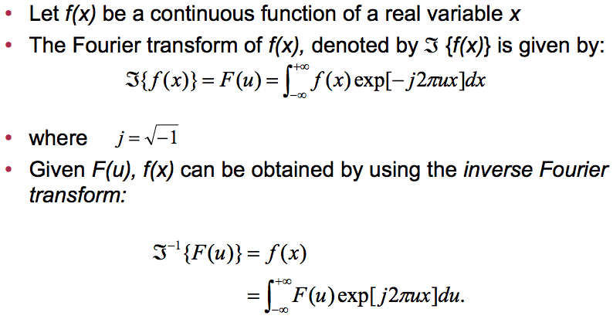
Introduction to the Fourier Transform
Notes:
6

Slide 7
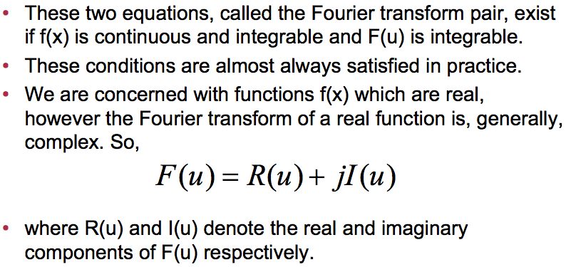
The Fourier Transform (continued)
Notes:
7

Slide 8
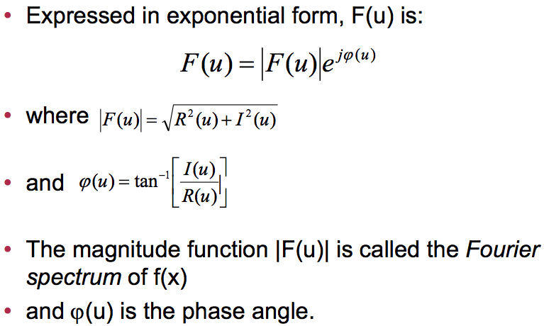
The Fourier Transform (continued)
Notes:
8

Slide 9
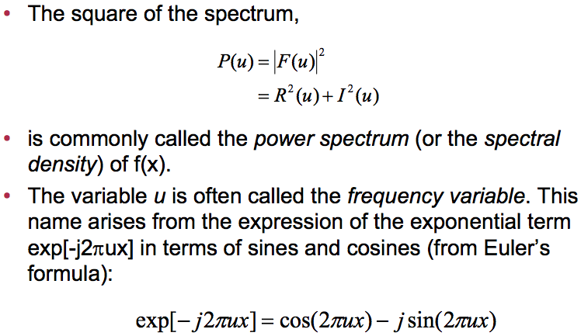
The Fourier Transform (continued)
Notes:
9

Slide 10
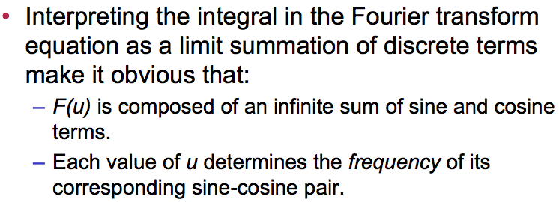
The Fourier Transform (continued)
Notes:
10

Slide 11
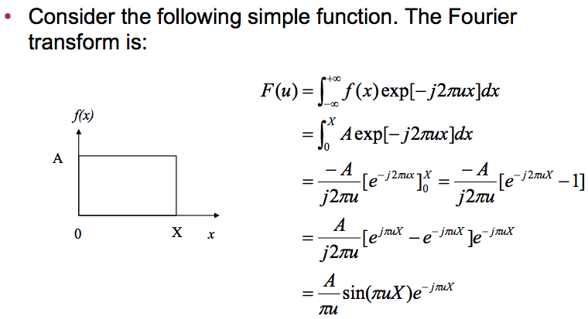
The Fourier Transform (Example)
Notes:
11

Slide 12
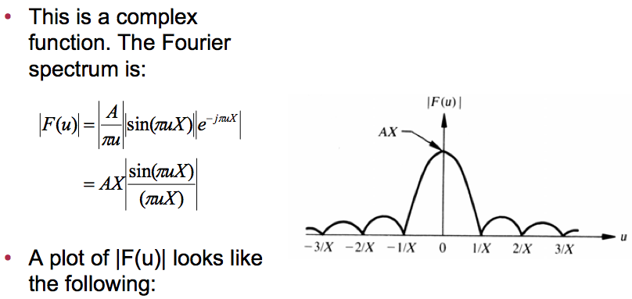
The Fourier Transform (Example)
Notes:
12

Slide 13
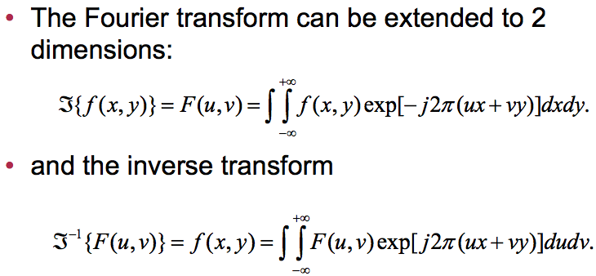
The 2-D Fourier Transform
Notes:
13

Slide 14
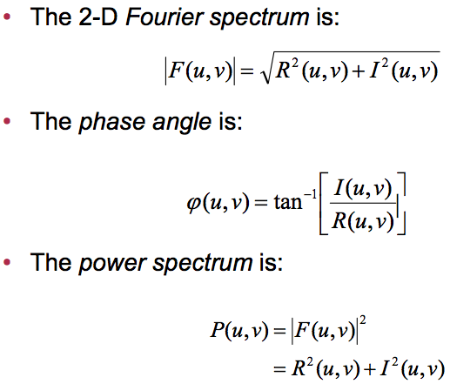
The 2-D Fourier Transform (Continued)
Notes:
14

Slide 15
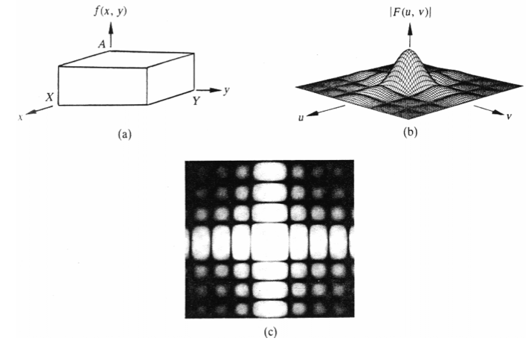
Sample 2-D function and its Fourier spectrum
Notes:
15

Slide 16
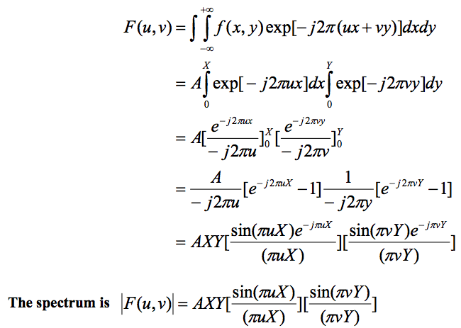
Example 2-D Fourier transform
Notes:
16

Slide 17
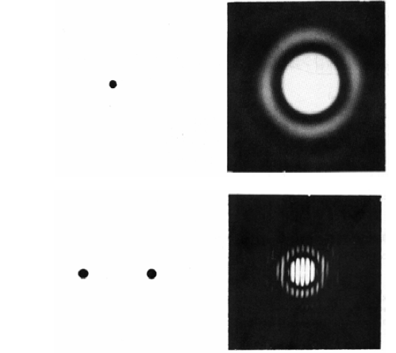
Example 2-D functions and their spectra
Notes:
17

Slide 18
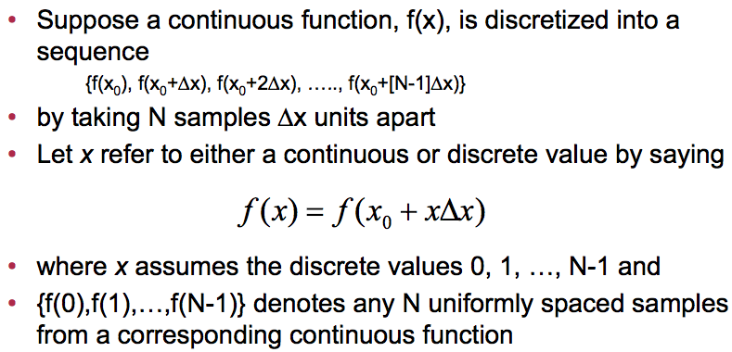
The discrete Fourier transform
Notes:
18

Slide 19
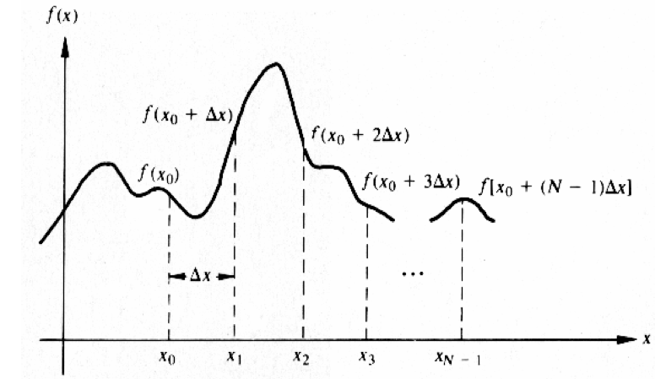
Sampling a continuous function
Notes:
19

Slide 20
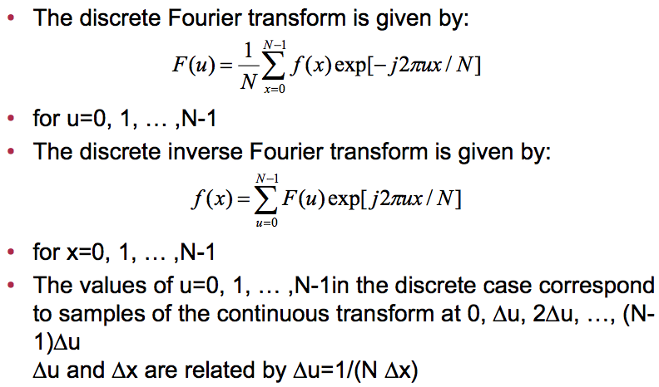
The discrete Fourier transform pair
Notes:
20

Slide 21
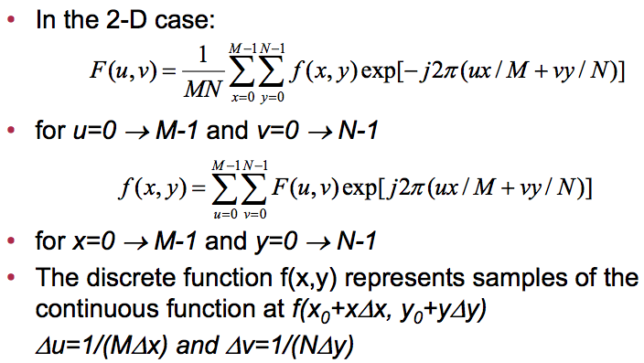
The 2-D discrete Fourier transform
Notes:
21

Slide 22
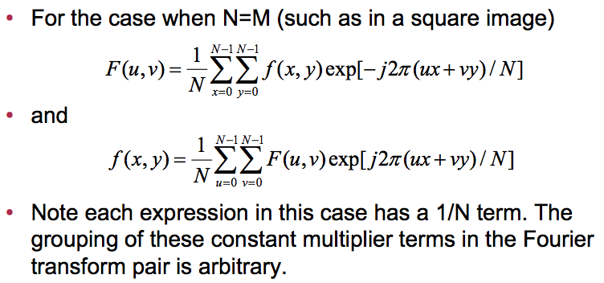
The 2-D discrete Fourier transform (continued)
Notes:
22

Slide 23
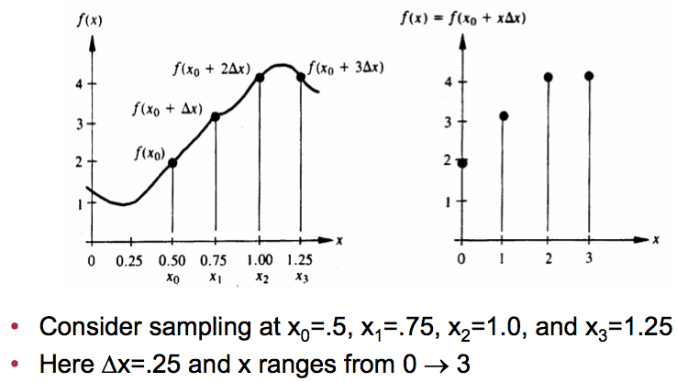
Discrete Fourier transform example
Notes:
23

Slide 24
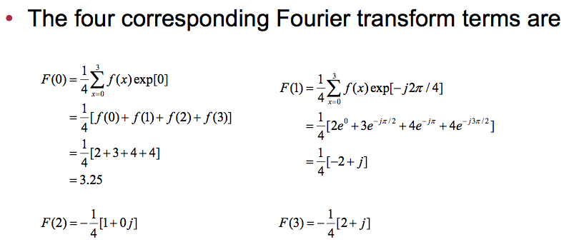
Discrete Fourier transform example (continued)
Notes:
24

Slide 25
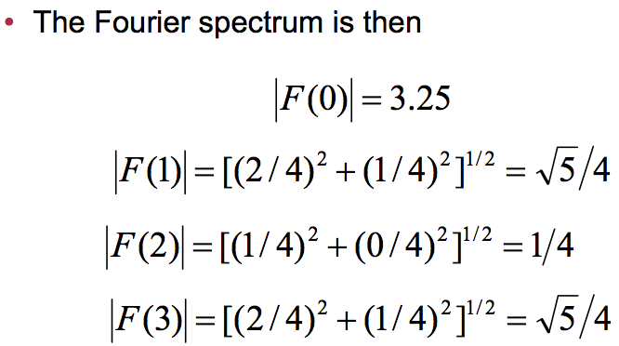
Discrete Fourier transform example (continued)
Notes:
25

Slide 26
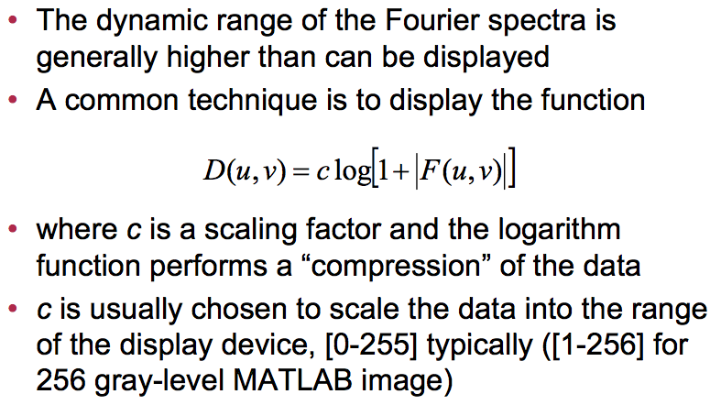
Properties of the 2-D Fourier transform
Notes:
26

Slide 27
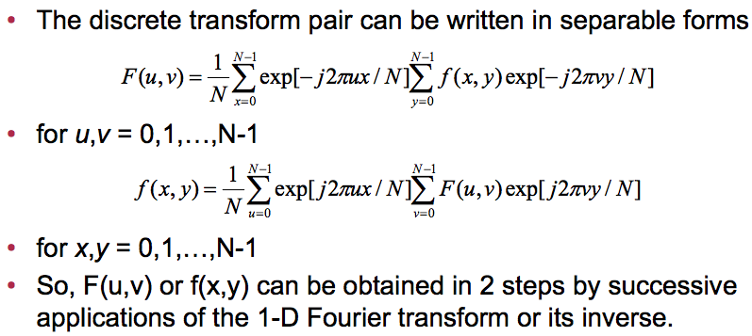
Separability
Notes:
27

Slide 28
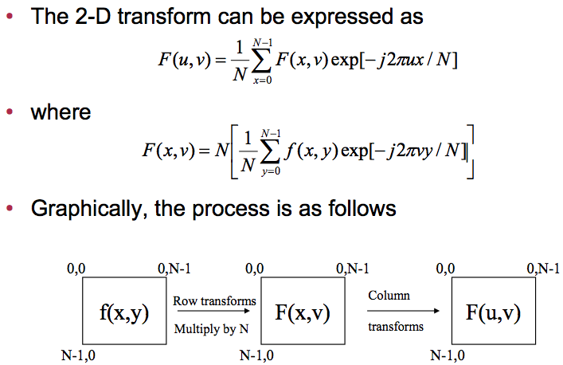
Separability (continued)
Notes:
28

Slide 29
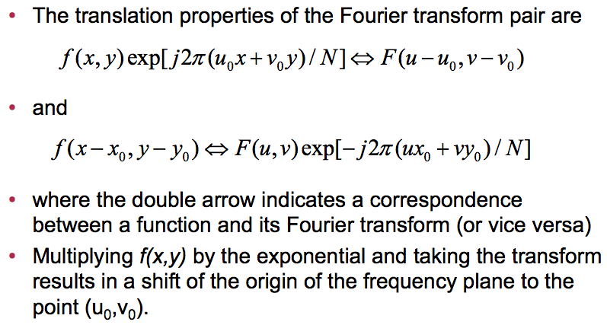
Translation
Notes:
29

Slide 30
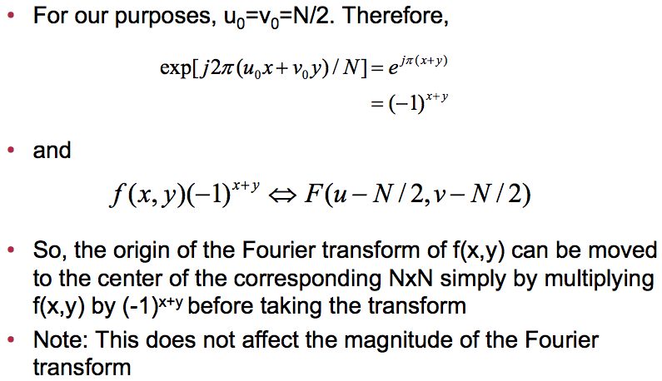
Translation (continued)
Notes:
30

Slide 31
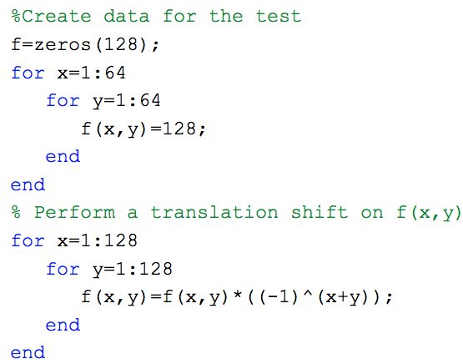
Matlab example
Notes:
31

Slide 32
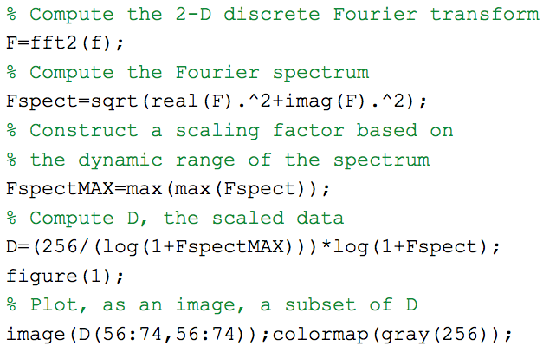
Matlab example (continued)
Notes:
32

Slide 33
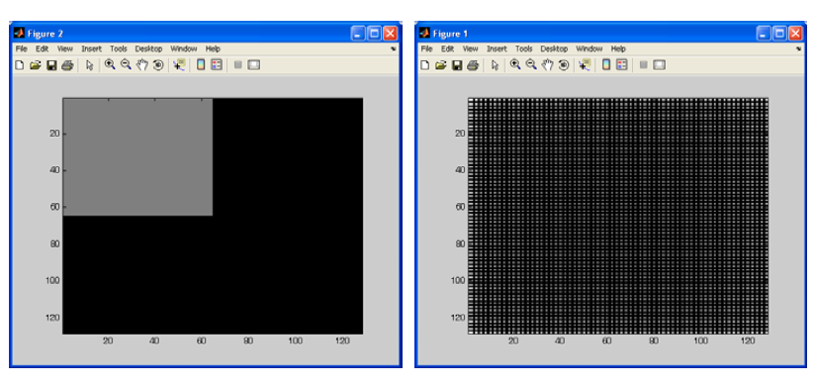
Example image and complete, scaled Fourier spectrum plot
Notes:
33

Slide 34
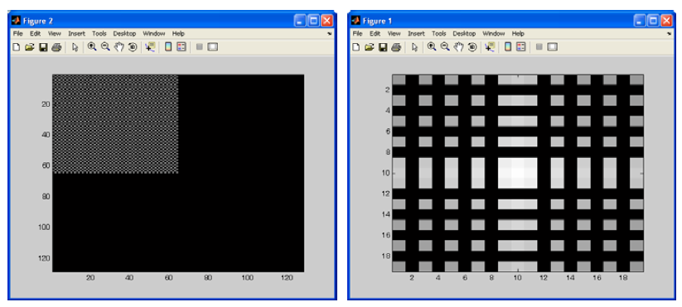
Example image and partial, scaled Fourier spectrum plot (with shifted f(x,y))
Notes:
34

Slide 35
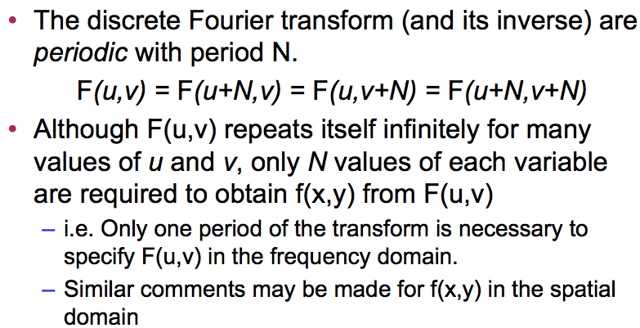
Periodicity of the Fourier transform
Notes:
35

Slide 36
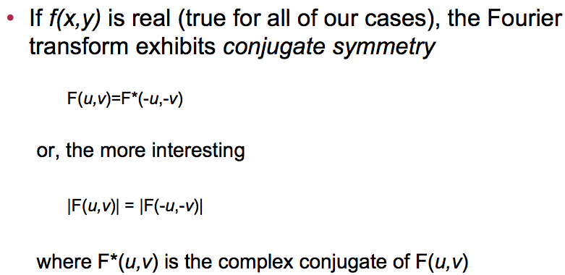
Conjugate symmetry of the Fourier transform
Notes:
36

Slide 37
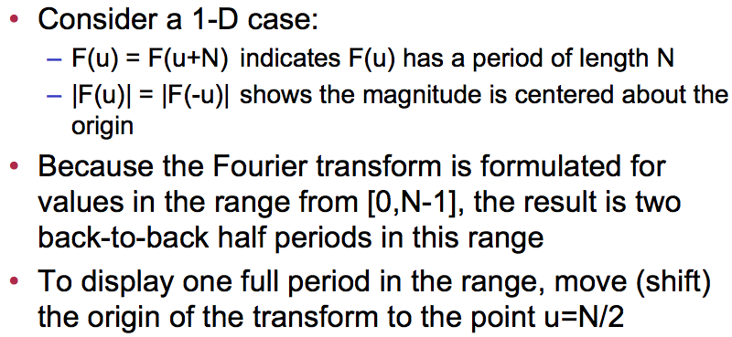
Implications of periodicity & symmetry
Notes:
37

Slide 38
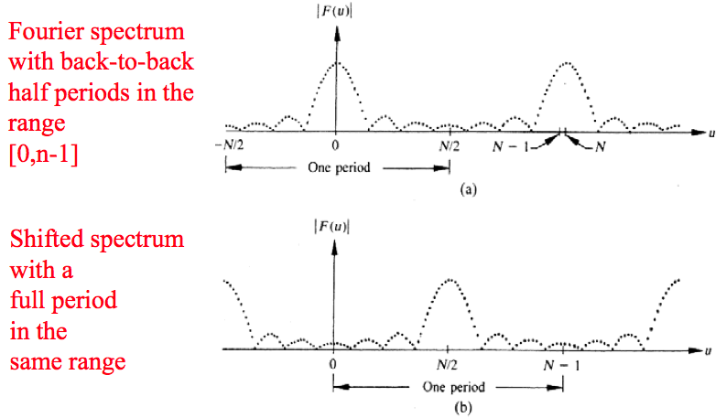
Periodicity properties
Notes:
38

Slide 39
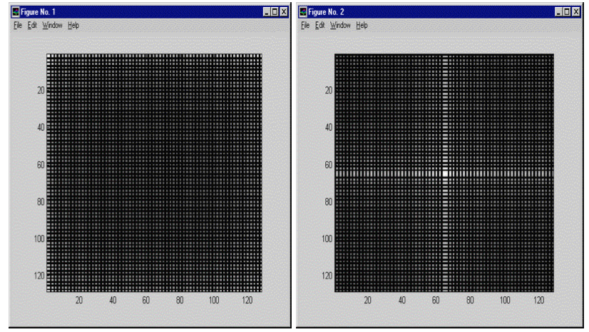
Periodicity properties: 2-D Example
Notes:
39

Slide 40
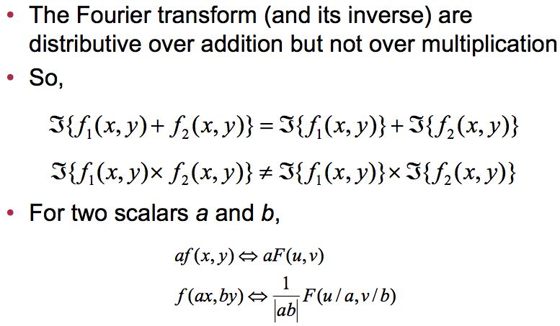
Distributivity & Scaling
Notes:
40

Slide 41
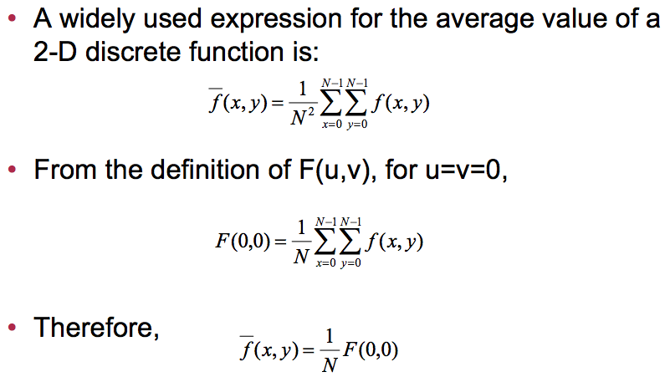
Average Value
Notes:
41

Slide 42
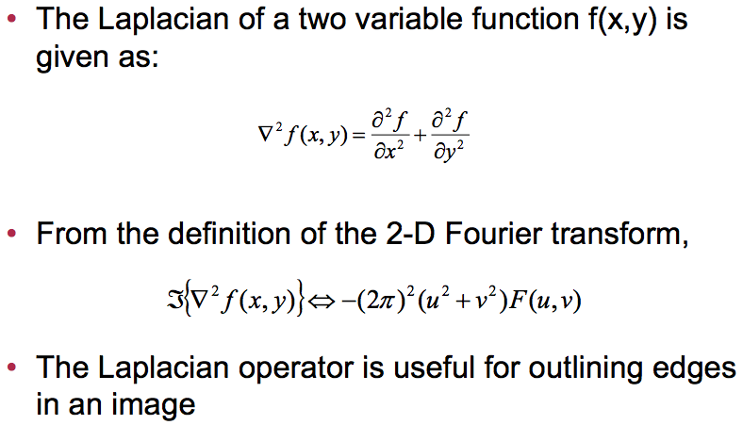
The Laplacian
Notes:
42

Slide 43
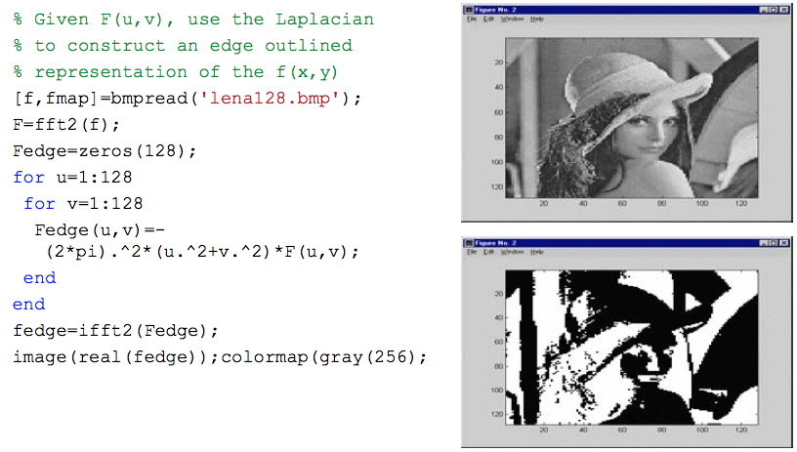
The Laplacian: Matlab example
Notes:
43

Slide 44
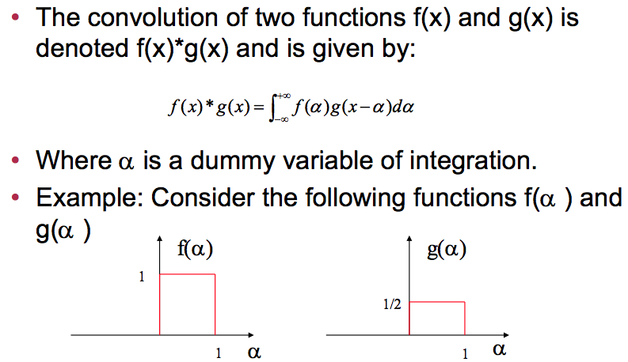
Convolution & Correlation
Notes:
44

Slide 45
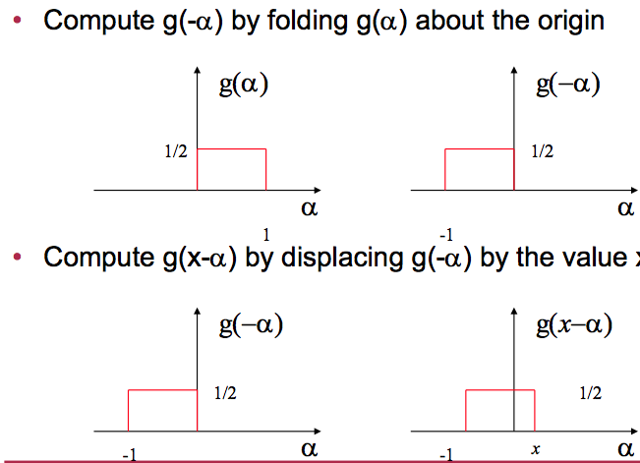
1-D convolution example
Notes:
45

Slide 46
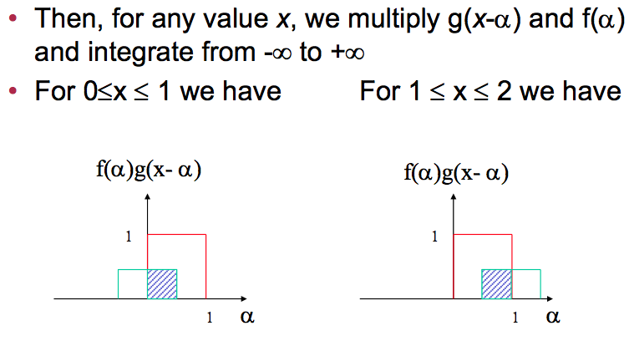
1-D convolution example (continued)
Notes:
46

Slide 47
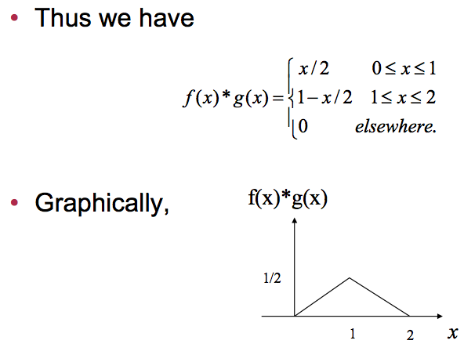
1-D convolution example (continued)
Notes:
47

Slide 48
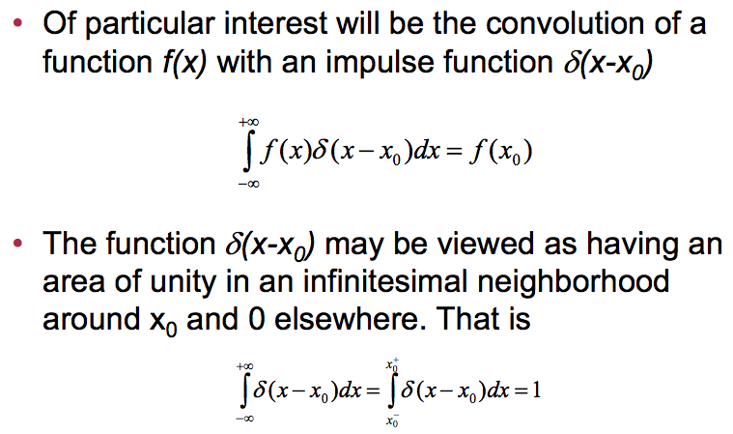
Convolution and impulse functions
Notes:
48

Slide 49
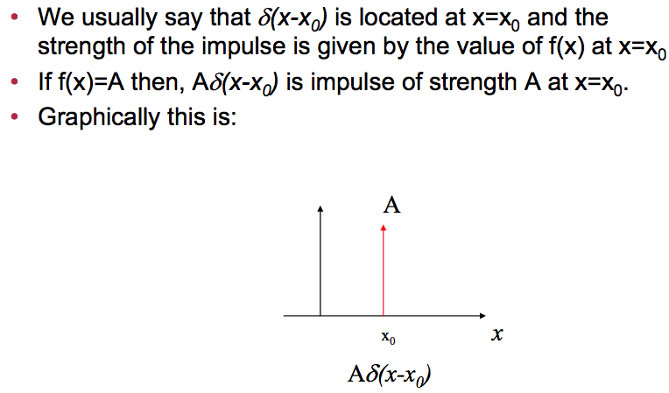
Convolution and impulse functions (continued)
Notes:
49

Slide 50
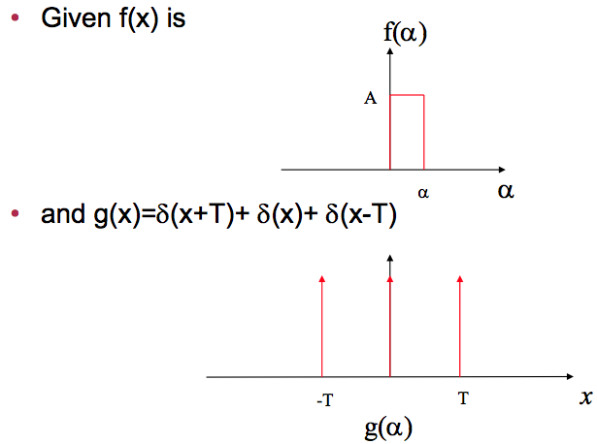
Convolution with an impulse function
Notes:
50

Slide 51
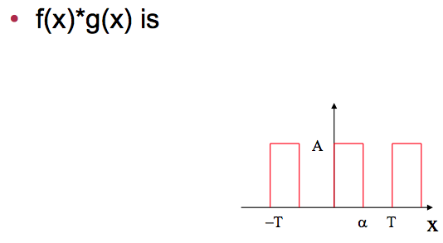
Convolution with an impulse function (continued)
Notes:
51

Slide 52
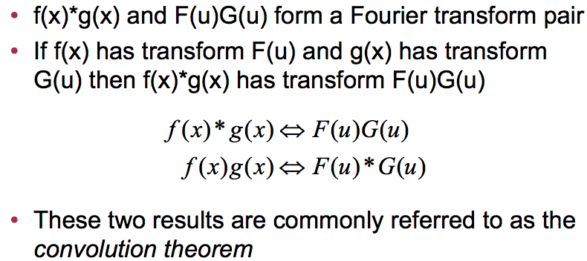
Convolution and the Fourier transform
Notes:
52

Slide 53

Frequency domain filtering
Notes:
53

Slide 54

Lowpass frequency domain filtering
Notes:
54

Slide 55

Ideal lowpass filter (ILPF)
Notes:
55

Slide 56

Ideal lowpass filter (ILPF) (continued)
Notes:
56

Slide 57
The Discrete Fourier Transform (DFT)
The Discrete Fourier Transform of f(x, y), for x = 0, 1, 2…M-1 and y = 0,1,2…N-1, denoted by F(u, v), is given by the equation:
for u = 0, 1, 2…M-1 and v = 0, 1, 2…N-1.
Notes:
57

Slide 58

DFT & Images
The DFT of a two dimensional image can be visualised by showing the spectrum of the images component frequencies
DFT
Images taken from Gonzalez & Woods, Digital Image Processing (2002)
Notes:
58

Slide 59
DFT & Images
Images taken from Gonzalez & Woods, Digital Image Processing (2002)
Notes:
59

Slide 60
DFT & Images
Images taken from Gonzalez & Woods, Digital Image Processing (2002)
Notes:
60

Slide 61

DFT & Images (cont…)
DFT
Images taken from Gonzalez & Woods, Digital Image Processing (2002)
Scanning electron microscope image of an integrated circuit magnified ~2500 times
Fourier spectrum of the image
Notes:
61

Slide 62
DFT & Images (cont…)
Images taken from Gonzalez & Woods, Digital Image Processing (2002)
Notes:
62

Slide 63
DFT & Images (cont…)
Images taken from Gonzalez & Woods, Digital Image Processing (2002)
Notes:
63

Slide 64
The Inverse DFT
It is really important to note that the Fourier transform is completely reversible
The inverse DFT is given by:
for x = 0, 1, 2…M-1 and y = 0, 1, 2…N-1
Notes:
64

Slide 65
The DFT and Image Processing
To filter an image in the frequency domain:
Multiply the input image by (-1)^{x+y} to center the transform.
Compute F(u,v) the DFT of the image
Multiply F(u,v) by a filter function H(u,v)
Compute the inverse DFT of the result in (3)
Obtain the real part of the result in (4)
Multiply the result in (5) by (-1)^{x+y}
Images taken from Gonzalez & Woods, Digital Image Processing (2002)
Notes:
65

Slide 66

The DFT and Image Processing
Images taken from Gonzalez & Woods, Digital Image Processing (2002)
Notes:
66

Slide 67

Some Basic Frequency Domain Filters
Low Pass Filter
Images taken from Gonzalez & Woods, Digital Image Processing (2002)
High Pass Filter
Notes:
67

Slide 68
Some Basic Frequency Domain Filters
Images taken from Gonzalez & Woods, Digital Image Processing (2002)
Notes:
68

Slide 69
Some Basic Frequency Domain Filters
Images taken from Gonzalez & Woods, Digital Image Processing (2002)
Notes:
69

Slide 70
Smoothing Frequency Domain Filters
Smoothing is achieved in the frequency domain by dropping out the high frequency components
The basic model for filtering is:
G(u,v) = H(u,v)F(u,v)
where F(u,v) is the Fourier transform of the image being filtered and H(u,v) is the filter transform function
Low pass filters – only pass the low frequencies, drop the high ones
Notes:
70

Slide 71

Ideal Low Pass Filter
Simply cut off all high frequency components that are a specified distance D₀ from the origin of the transform
changing the distance changes the behaviour of the filter
Images taken from Gonzalez & Woods, Digital Image Processing (2002)
Notes:
71

Slide 72
Ideal Low Pass Filter (cont…)
The transfer function for the ideal low pass filter can be given as:
where D(u,v) is given as:
Notes:
72

Slide 73

Ideal Low Pass Filter (cont…)
Images taken from Gonzalez & Woods, Digital Image Processing (2002)
Above we show an image, it’s Fourier spectrum and a series of ideal low pass filters of radius 5, 15, 30, 80 and 230 superimposed on top of it
Notes:
73

Slide 74
Ideal Low Pass Filter (cont…)
Images taken from Gonzalez & Woods, Digital Image Processing (2002)
Notes:
74

Slide 75
Ideal Low Pass Filter (cont…)
Images taken from Gonzalez & Woods, Digital Image Processing (2002)
Notes:
75

Slide 76

Ideal Low Pass Filter (cont…)
Result of filtering with ideal low pass filter of radius 5
Original image
Result of filtering with ideal low pass filter of radius 15
Result of filtering with ideal low pass filter of radius 30
Images taken from Gonzalez & Woods, Digital Image Processing (2002)
Result of filtering with ideal low pass filter of radius 80
Result of filtering with ideal low pass filter of radius 230
Notes:
76

Slide 77
Ideal Low Pass Filter (cont…)
Result of filtering with ideal low pass filter of radius 5
Images taken from Gonzalez & Woods, Digital Image Processing (2002)
Notes:
77

Slide 78
Ideal Low Pass Filter (cont…)
Result of filtering with ideal low pass filter of radius 15
Images taken from Gonzalez & Woods, Digital Image Processing (2002)
Notes:
78

Slide 79

Chapter 4
Image Enhancement in the
Frequency Domain

Slide 80

Butterworth Lowpass Filters
The transfer function of a Butterworth lowpass filter of order n with cutoff frequency at distance D₀ from the origin is defined as:
Images taken from Gonzalez & Woods, Digital Image Processing (2002)
Notes:
80

Slide 81

Butterworth Lowpass Filter (cont…)
Result of filtering with Butterworth filter of order 2 and cutoff radius 5
Original image
Result of filtering with Butterworth filter of order 2 and cutoff radius 15
Result of filtering with Butterworth filter of order 2 and cutoff radius 30
Images taken from Gonzalez & Woods, Digital Image Processing (2002)
Result of filtering with Butterworth filter of order 2 and cutoff radius 80
Result of filtering with Butterworth filter of order 2 and cutoff radius 230
Notes:
81

Slide 82
Butterworth Lowpass Filter (cont…)
Original image
Result of filtering with Butterworth filter of order 2 and cutoff radius 5
Images taken from Gonzalez & Woods, Digital Image Processing (2002)
Notes:
82

Slide 83
Butterworth Lowpass Filter (cont…)
Result of filtering with Butterworth filter of order 2 and cutoff radius 15
Images taken from Gonzalez & Woods, Digital Image Processing (2002)
Notes:
83

Slide 84

Chapter 4
Image Enhancement in the
Frequency Domain

Slide 85

Gaussian Lowpass Filters
The transfer function of a Gaussian lowpass filter is defined as:
Images taken from Gonzalez & Woods, Digital Image Processing (2002)
Notes:
85

Slide 86

Gaussian Lowpass Filters (cont…)
Result of filtering with Gaussian filter with cutoff radius 5
Original image
Result of filtering with Gaussian filter with cutoff radius 15
Result of filtering with Gaussian filter with cutoff radius 30
Images taken from Gonzalez & Woods, Digital Image Processing (2002)
Result of filtering with Gaussian filter with cutoff radius 85
Result of filtering with Gaussian filter with cutoff radius 230
Notes:
86

Slide 87
Lowpass Filters Compared
Result of filtering with ideal low pass filter of radius 15
Result of filtering with Butterworth filter of order 2 and cutoff radius 15
Images taken from Gonzalez & Woods, Digital Image Processing (2002)
Result of filtering with Gaussian filter with cutoff radius 15
Notes:
87

Slide 88

Lowpass Filtering Examples
A low pass Gaussian filter is used to connect broken text
Images taken from Gonzalez & Woods, Digital Image Processing (2002)
Notes:
88

Slide 89
Lowpass Filtering Examples
Images taken from Gonzalez & Woods, Digital Image Processing (2002)
Notes:
89

Slide 90

Lowpass Filtering Examples (cont…)
Different lowpass Gaussian filters used to remove blemishes in a photograph
Images taken from Gonzalez & Woods, Digital Image Processing (2002)
Notes:
90

Slide 91
Lowpass Filtering Examples (cont…)
Images taken from Gonzalez & Woods, Digital Image Processing (2002)
Notes:
91

Slide 92

Lowpass Filtering Examples (cont…)
Original image
Gaussian lowpass filter
Images taken from Gonzalez & Woods, Digital Image Processing (2002)
Spectrum of original image
Processed image
Notes:
92

Slide 93
Sharpening in the Frequency Domain
Edges and fine detail in images are associated with high frequency components
High pass filters – only pass the high frequencies, drop the low ones
High pass frequencies are precisely the reverse of low pass filters, so:
H_{hp}(u, v) = 1 – H_{lp}(u, v)
Notes:
93

Slide 94

Ideal High Pass Filters
The ideal high pass filter is given as:
where D₀ is the cut off distance as before
Images taken from Gonzalez & Woods, Digital Image Processing (2002)
Notes:
94

Slide 95

Ideal High Pass Filters (cont…)
Images taken from Gonzalez & Woods, Digital Image Processing (2002)
Results of ideal high pass filtering with D₀ = 15
Results of ideal high pass filtering with D₀ = 30
Results of ideal high pass filtering with D₀ = 80
Notes:
95

Slide 96
Butterworth High Pass Filters
The Butterworth high pass filter is given as:
where n is the order and D₀ is the cut off distance as before
Images taken from Gonzalez & Woods, Digital Image Processing (2002)
Notes:
96

Slide 97

Butterworth High Pass Filters (cont…)
Results of Butterworth high pass filtering of order 2 with D₀ = 15
Images taken from Gonzalez & Woods, Digital Image Processing (2002)
Results of Butterworth high pass filtering of order 2 with D₀ = 80
Results of Butterworth high pass filtering of order 2 with D₀ = 30
Notes:
97

Slide 98
Gaussian High Pass Filters
The Gaussian high pass filter is given as:
where D₀ is the cut off distance as before
Images taken from Gonzalez & Woods, Digital Image Processing (2002)
Notes:
98

Slide 99

Gaussian High Pass Filters (cont…)
Images taken from Gonzalez & Woods, Digital Image Processing (2002)
Results of Gaussian high pass filtering with D₀ = 80
Results of Gaussian high pass filtering with D₀ = 15
Results of Gaussian high pass filtering with D₀ = 30
Notes:
99

Slide 100
Highpass Filter Comparison
Results of ideal high pass filtering with D₀ = 15
Images taken from Gonzalez & Woods, Digital Image Processing (2002)
Notes:
100

Slide 101
Highpass Filter Comparison
Results of Butterworth high pass filtering of order 2 with D₀ = 15
Images taken from Gonzalez & Woods, Digital Image Processing (2002)
Notes:
101

Slide 102
Highpass Filter Comparison
Results of Gaussian high pass filtering with D₀ = 15
Images taken from Gonzalez & Woods, Digital Image Processing (2002)
Notes:
102

Slide 103
Highpass Filter Comparison
Images taken from Gonzalez & Woods, Digital Image Processing (2002)
Results of ideal high pass filtering with D₀ = 15
Results of Butterworth high pass filtering of order 2 with D₀ = 15
Results of Gaussian high pass filtering with D₀ = 15
Notes:
103

Slide 104
Highpass Filter Comparison
Results of ideal high pass filtering with D₀ = 15
Images taken from Gonzalez & Woods, Digital Image Processing (2002)
Notes:
104

Slide 105
Highpass Filter Comparison
Results of Butterworth high pass filtering of order 2 with D₀ = 15
Images taken from Gonzalez & Woods, Digital Image Processing (2002)
Notes:
105

Slide 106
Highpass Filter Comparison
Results of Gaussian high pass filtering with D₀ = 15
Images taken from Gonzalez & Woods, Digital Image Processing (2002)
Notes:
106

Slide 107

Chapter 4
Image Enhancement in the
Frequency Domain

Slide 108

Chapter 4
Image Enhancement in the
Frequency Domain

Slide 109

Highpass Filter Comparison
Images taken from Gonzalez & Woods, Digital Image Processing (2002)
Notes:
109

Slide 110

Highpass Filter Comparison
Images taken from Gonzalez & Woods, Digital Image Processing (2002)
Notes:
110

Slide 111
Highpass Filter Comparison
The process consists of multiplying the composite filter by the (centered) transform of the input image and then taking the inverse transform of the product. Multiplication of the real part of this result by (-1)^{x+y} gives us the high-boost filtered image f_{hb}(x,y) in the spatial domain.
Images taken from Gonzalez & Woods, Digital Image Processing (2002)
Notes:
111

Slide 112

Highpass Filtering Example
Original image
Highpass filtering result
Images taken from Gonzalez & Woods, Digital Image Processing (2002)
High frequency emphasis result
After histogram equalisation
Notes:
112

Slide 113
Highpass Filtering Example
Notes:
113

Slide 114
Highpass Filtering Example
Notes:
114

Slide 115
Highpass Filtering Example
Notes:
115

Slide 116
Highpass Filtering Example
Notes:
116

Slide 117

Laplacian In The Frequency Domain
Images taken from Gonzalez & Woods, Digital Image Processing (2002)
Notes:
117

Slide 118

Laplacian In The Frequency Domain
Images taken from Gonzalez & Woods, Digital Image Processing (2002)
Equation (1) gives the laplacian result whereas equation (2) and (3) gives the enhanced image after taking the laplacian.
Notes:
118

Slide 119

Laplacian In The Frequency Domain
2-D image of Laplacian in the frequency domain
Laplacian in the frequency domain
Images taken from Gonzalez & Woods, Digital Image Processing (2002)
Inverse DFT of Laplacian in the frequency domain
Zoomed section of the image on the left compared to spatial filter
Notes:
119

Slide 120

Frequency Domain Laplacian Example
Original image
Laplacian filtered image
Laplacian image scaled
Enhanced image
Notes:
120

Slide 121
Fast Fourier Transform
The reason that Fourier based techniques have become so popular is the development of the Fast Fourier Transform (FFT) algorithm
Allows the Fourier transform to be carried out in a reasonable amount of time
Reduces the amount of time required to perform a Fourier transform by a factor of 100 – 600 times!
Notes:
121

Slide 122
Frequency Domain Filtering & Spatial Domain Filtering
Similar jobs can be done in the spatial and frequency domains
Filtering in the spatial domain can be easier to understand
Filtering in the frequency domain can be much faster – especially for large images
Notes:
122

Slide 123

The Fast Fourier Transform (FFT)
Notes:
123

Slide 124

The Fast Fourier Transform (FFT)
Notes:
124

Slide 125

The Fast Fourier Transform (FFT)
Notes:
125

Slide 126

The Fast Fourier Transform (FFT)
Notes:
126

Slide 127

The Fast Fourier Transform (FFT)
Notes:
127

Slide 128

The Fast Fourier Transform (FFT)
Notes:
128

Slide 129

Chapter 4
Image Enhancement in the
Frequency Domain

Slide 130

Convolution and Padding
Notes:
130

Slide 131

Chapter 4
Image Enhancement in the
Frequency Domain

Slide 132


Convolution and Padding
Notes:
132

Slide 133

Chapter 4
Image Enhancement in the
Frequency Domain

Slide 134

Chapter 4
Image Enhancement in the
Frequency Domain

Slide 135


2D Convolution and Padding
Notes:
135

Slide 136


Chapter 4
Image Enhancement in the
Frequency Domain

Slide 137


2D Convolution
Notes:
137

Slide 138


2D Correlation
Notes:
138

Slide 139
Notes:
139

Slide 140
Notes:
140

Slide 141


Chapter 4
Image Enhancement in the
Frequency Domain

